Slide 1

Arcaninjandroid: Kitty Catastrophe
By Rémy Lapointe
Pitch date: June 3rd 2018

Slide 2

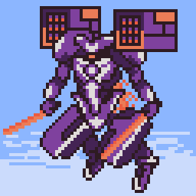
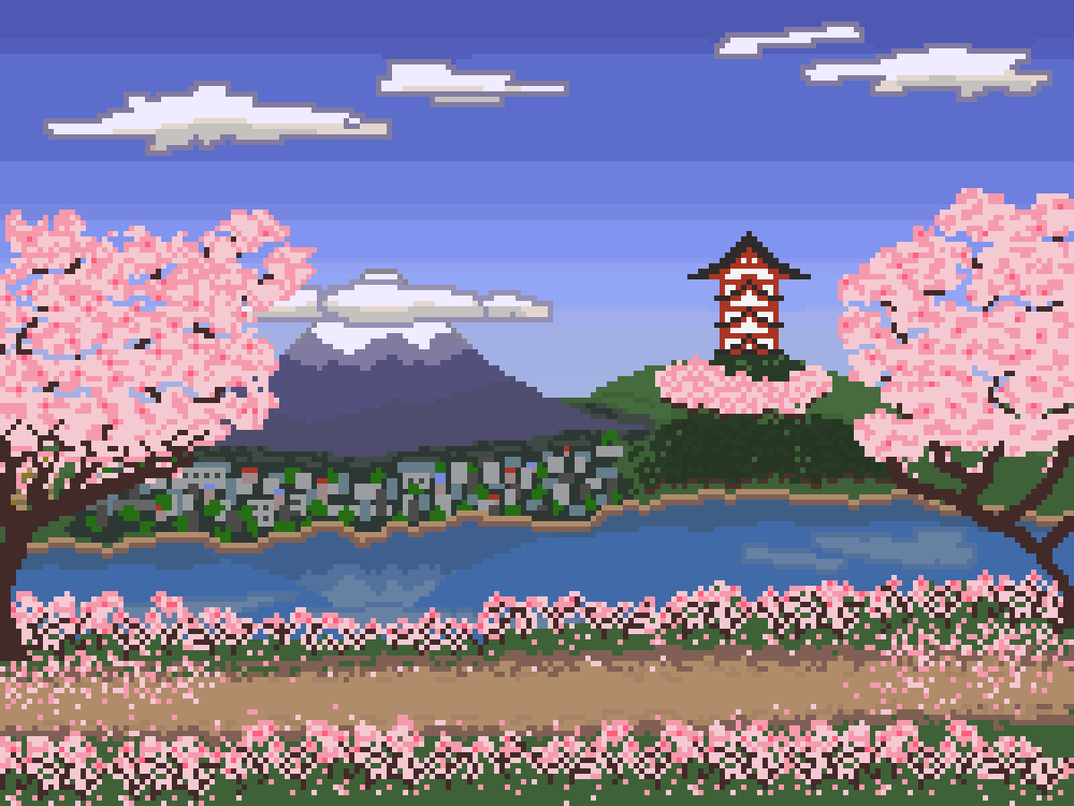
Who am I?
Led Spell Spiel during Summer 2017
Helped out on various club projects since, and other personal endeavours
Physics and CS by day, resident pixel artist by night

Slide 3
We’re making…
A side-scrolling action beat’em up!

Slide 4

The basics
Javascript/HTML5 on Canvas
Pixelated style
4 months (until September 30th)

Slide 5
The story
Aliens have arrived on Earth
They’ve agreed to leave forever, in exchange for most of Earth’s kittens
Refusing to surrender your friend, you spent 8 years mastering ninja techniques, learning the magical arts, and augmenting yourself with robotic parts. The first Arcaninjandroid. Now, you must rescue Kitten!!!

Slide 6
The gameplay
You must use your three fighting styles : Arcane, Ninja and Android.
Android is for ground combat, punches and kicks. With enough hits, you can stun opponents.
Launch stunned enemies in the air and become Ninja. You slice and dice swiftly in the air and rack up combos.
When the combo is over, you switch to Arcane. You can fly and shoot spells like mad, while the power depends on your previous ninja combo.
TLDR: Android on ground, Ninja in air, Arcane as finisher.

Slide 7

“Remy, you’re insane, and this is a stupid idea.”

Slide 8
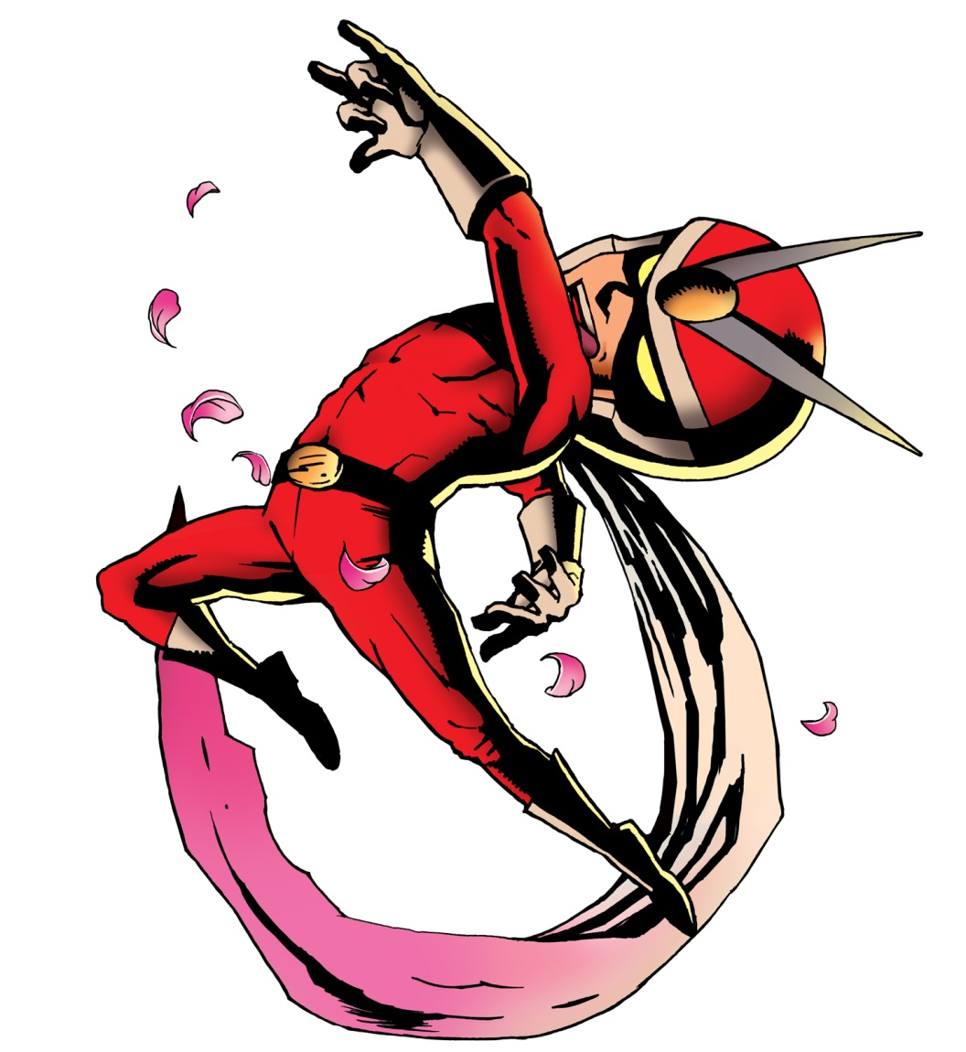
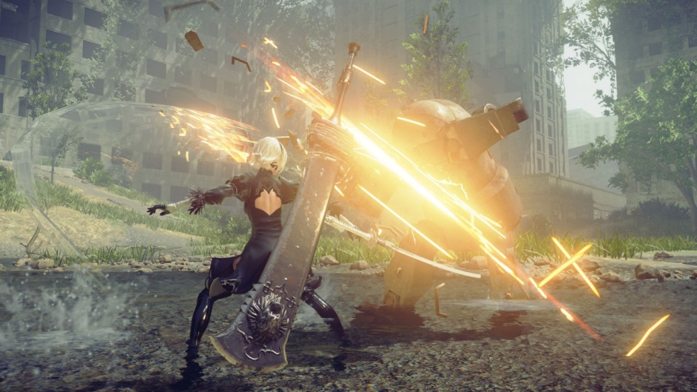
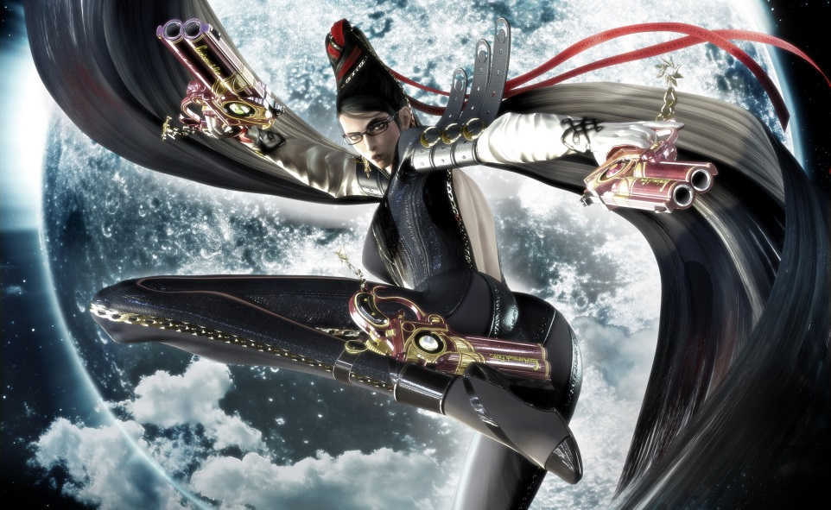
The inspiration
Early to current day Platinum Games
Focus on action and fluid, stylish combat

Slide 9
Demo time!!!

Slide 10

The main challenges
Animating humans. I’ve been practicing in prep for this.
Fluid, satisfying gameplay. Will need help with gameplay design and handling complex inputs.
What you can do:
Environment/level design
Minimalistic UI: combo counter and HP bar etc.
Enemy design, art, implementation etc.
Animation: difficulty will vary a lot!
SFX: many kicks will be received in the face!
Action music!!! :D
If you’re up to the challenge: help me with the gameplay/engine code. There is much advanced coding (state machines, animation, tricky collision detection and more) we can figure out together! :D

Slide 11
Schedule
Week of June 3rd: Pitch, Android gameplay, start main char sprite, begin UI and Audio module, discuss gameplay, fix engine bugs if any
Week of June 10th: More Android gameplay, start first background art, finish previous week, start main menu, first enemy sprite WIP.
Week of June 17th: Put Android aside, finish main menu, continue from previous. (I have exams)
Week of June 24th: Start Ninja gameplay, introduce the concept of “level”, continue background.
This has us all set for the coming month; I will try my best to keep the Trello updated and have at least 2 more weeks planned at any given time.

Slide 12

Questions? :)

